Slide 1
Collaborative Filtering: A Tutorial
(abridged version of tutorial from my Web page)
William W. Cohen
Machine Learning Dept
Carnegie Mellon University

Slide 2
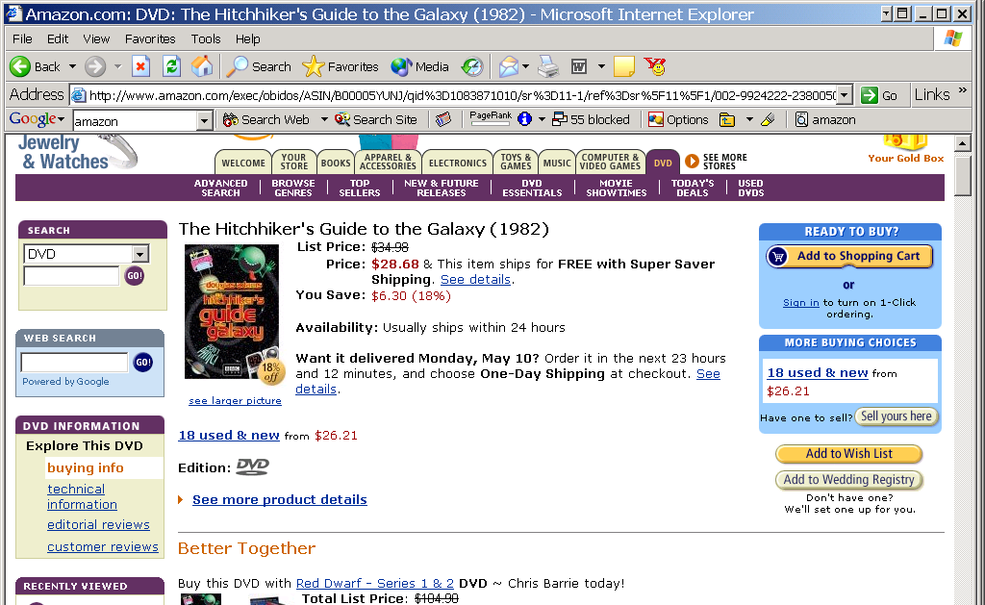
Everyday Examples of Collaborative Filtering...

Slide 3
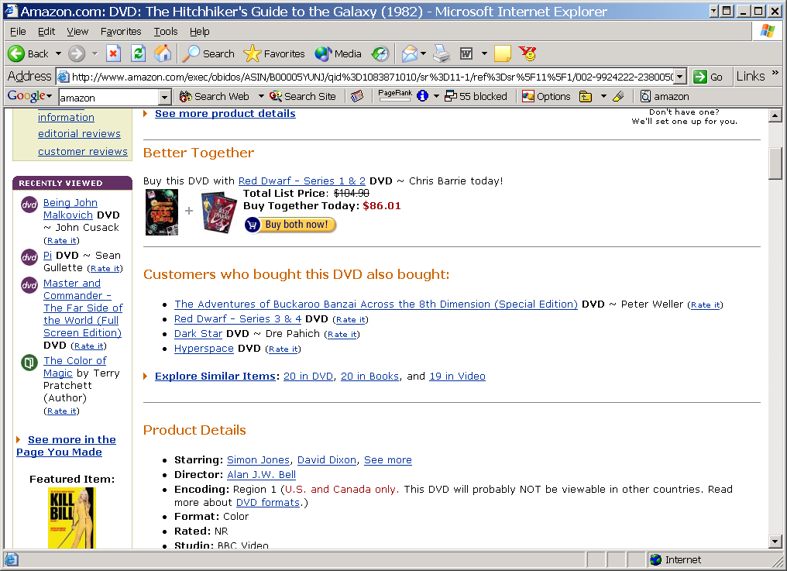
Rate it?
The Dark Star's crew is on a 20-year mission ..but unlike Star Trek... the nerves of this crew are ... frayed to the point of psychosis. Their captain has been killed by a radiation leak that also destroyed their toilet paper. "Don't give me any of that 'Intelligent Life' stuff," says Commander Doolittle when presented with the possibility of alien life. "Find me something I can blow up.“...

Slide 4
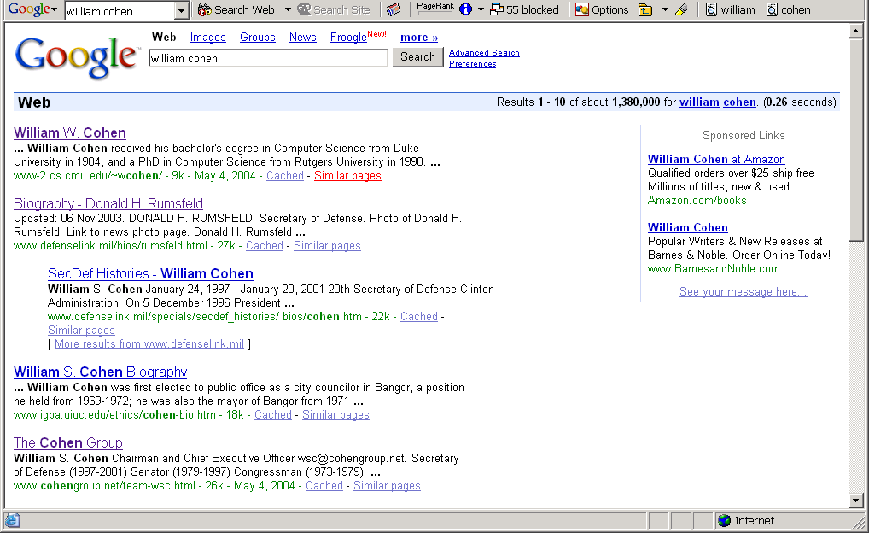
Everyday Examples of Collaborative Filtering...

Slide 5
Everyday Examples of Collaborative Filtering...

Slide 6
Google’s PageRank
Inlinks are “good” (recommendations)
Inlinks from a “good” site are better than inlinks from a “bad” site
but inlinks from sites with many outlinks are not as “good”...
“Good” and “bad” are relative.
web site xxx
web site xxx
web site xxx
web site a b c d e f g
web
site
pdq pdq ..
web site yyyy
web site a b c d e f g
web site yyyy

Slide 7
Google’s PageRank
web site xxx
Imagine a “pagehopper” that always either
follows a random link, or
jumps to random page
web site xxx
web site a b c d e f g
web
site
pdq pdq ..
web site yyyy
web site a b c d e f g
web site yyyy

Slide 8
Google’s PageRank
(Brin & Page, http://www-db.stanford.edu/~backrub/google.html)
web site xxx
Imagine a “pagehopper” that always either
follows a random link, or
jumps to random page
PageRank ranks pages by the amount of time the pagehopper spends on a page:
or, if there were many pagehoppers, PageRank is the expected “crowd size”
web site xxx
web site a b c d e f g
web
site
pdq pdq ..
web site yyyy
web site a b c d e f g
web site yyyy

Slide 9
Everyday Examples of Collaborative Filtering...
Bestseller lists
Top 40 music lists
The “recent returns” shelf at the library
Unmarked but well-used paths thru the woods
The printer room at work
Many weblogs
“Read any good books lately?”
....
Common insight: personal tastes are correlated:
  If Alice and Bob both like X and Alice likes Y then Bob is more likely to like Y
  especially (perhaps) if Bob knows Alice

Slide 10
Outline
Non-systematic survey of some CF systems
  CF as basis for a virtual community
  memory-based recommendation algorithms
  visualizing user-user via item distances
  CF versus content filtering
Algorithms for CF
CF with different inputs
  true ratings
  assumed/implicit ratings
Conclusions/Summary

Slide 11


BellCore’s MovieRecommender
?
?
Recommending And Evaluating Choices In A Virtual Community Of Use. Will Hill, Larry Stead, Mark Rosenstein and George Furnas, Bellcore; CHI 1995
  By virtual community we mean "a group of people who share characteristics and interact in essence or effect only". In other words, people in a Virtual Community influence each other as though they interacted but they do not interact. Thus we ask: "Is it possible to arrange for people to share some of the personalized informational benefits of community involvement without the associated communications costs?"

Slide 12
MovieRecommender Goals
Recommendations should:
simultaneously ease and encourage rather than replace social processes....should make it easy to participate while leaving in hooks for people to pursue more personal relationships if they wish.
be for sets of people not just individuals...multi-person recommending is often important, for example, when two or more people want to choose a video to watch together.
be from people not a black box machine or so-called "agent".
tell how much confidence to place in them, in other words they should include indications of how accurate they are.

Slide 13
BellCore’s MovieRecommender
Participants sent email to videos@bellcore.com
System replied with a list of 500 movies to rate on a 1-10 scale (250 random, 250 popular)
  Only subset need to be rated
New participant P sends in rated movies via email
System compares ratings for P to ratings of (a random sample of) previous users
Most similar users are used to predict scores for unrated movies (more later)
System returns recommendations in an email message.

Slide 14
Suggested Videos for: John A. Jamus.
Your must-see list with predicted ratings:
7.0 "Alien (1979)"
6.5 "Blade Runner"
6.2 "Close Encounters Of The Third Kind (1977)"
Your video categories with average ratings:
6.7 "Action/Adventure"
6.5 "Science Fiction/Fantasy"
6.3 "Children/Family"
6.0 "Mystery/Suspense"
5.9 "Comedy"
5.8 "Drama"

Slide 15
The viewing patterns of 243 viewers were consulted. Patterns of 7 viewers were found to be most similar. Correlation with target viewer:
0.59 viewer-130 (unlisted@merl.com)
0.55 bullert,jane r (bullert@cc.bellcore.com)
0.51 jan_arst (jan_arst@khdld.decnet.philips.nl)
0.46 Ken Cross (moose@denali.EE.CORNELL.EDU)
0.42 rskt (rskt@cc.bellcore.com)
0.41 kkgg (kkgg@Athena.MIT.EDU)
0.41 bnn (bnn@cc.bellcore.com)
By category, their joint ratings recommend:
Action/Adventure:
  "Excalibur" 8.0, 4 viewers
  "Apocalypse Now" 7.2, 4 viewers
  "Platoon" 8.3, 3 viewers
Science Fiction/Fantasy:
  "Total Recall" 7.2, 5 viewers
Children/Family:
  "Wizard Of Oz, The" 8.5, 4 viewers
  "Mary Poppins" 7.7, 3 viewers
Mystery/Suspense:
  "Silence Of The Lambs, The" 9.3, 3 viewers
Comedy:
  "National Lampoon's Animal House" 7.5, 4 viewers
  "Driving Miss Daisy" 7.5, 4 viewers
  "Hannah and Her Sisters" 8.0, 3 viewers
Drama:
  "It's A Wonderful Life" 8.0, 5 viewers
  "Dead Poets Society" 7.0, 5 viewers
  "Rain Man" 7.5, 4 viewers
Correlation of predicted ratings with your actual ratings is: 0.64 This number measures ability to evaluate movies accurately for you. 0.15 means low ability. 0.85 means very good ability. 0.50 means fair ability.

Slide 16
BellCore’s MovieRecommender
Evaluation:
  Withhold 10% of the ratings of each user to use as a test set
  Measure correlation between predicted ratings and actual ratings for test-set movie/user pairs

Slide 17
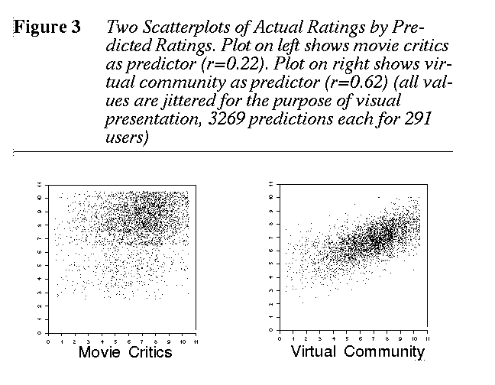

Slide 18
BellCore’s MovieRecommender
Participants sent email to videos@bellcore.com
System replied with a list of 500 movies to rate New participant P sends in rated movies via email
System compares ratings for P to ratings of (a random sample of) previous users
Most similar users are used to predict scores for unrated movies
  Empirical Analysis of Predictive Algorithms for Collaborative Filtering Breese, Heckerman, Kadie, UAI98
System returns recommendations in an email message.

Slide 19
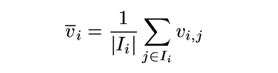
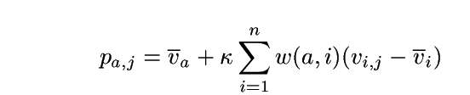
Algorithms for Collaborative Filtering 1: Memory-Based Algorithms (Breese et al, UAI98)
v_{i,j}= vote of user i on item j
I_{i} = items for which user i has voted
Mean vote for i is
Predicted vote for “active user” a is weighted sum
normalizer
weights of n similar users

Slide 20
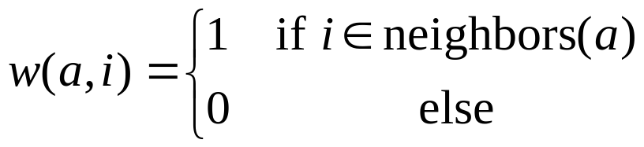
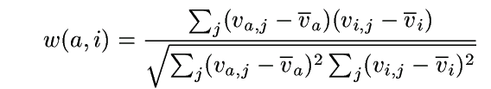
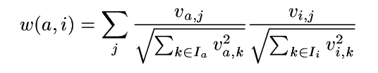
Algorithms for Collaborative Filtering 1: Memory-Based Algorithms (Breese et al, UAI98)
K-nearest neighbor
Pearson correlation coefficient (Resnick ’94, Grouplens):
Cosine distance (from IR)

Slide 21
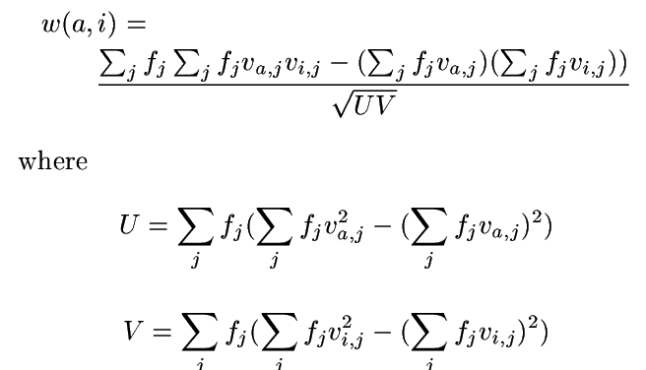
Algorithms for Collaborative Filtering 1: Memory-Based Algorithms (Breese et al, UAI98)
Cosine with “inverse user frequency” f_{i} = log(n/n_{j}), where n is number of users, n_{j} is number of users voting for item j

Slide 22
Algorithms for Collaborative Filtering 1: Memory-Based Algorithms (Breese et al, UAI98)
Evaluation:
  split users into train/test sets
  for each user a in the test set:
    split a’s votes into observed (I) and to-predict (P)
    measure average absolute deviation between predicted and actual votes in P
    predict votes in P, and form a ranked list
    assume (a) utility of k-th item in list is max(v_{a,j}-d,0), where d is a “default vote” (b) probability of reaching rank k drops exponentially in k. Score a list by its expected utility R_{a}
  average R_{a} over all test users

Slide 23
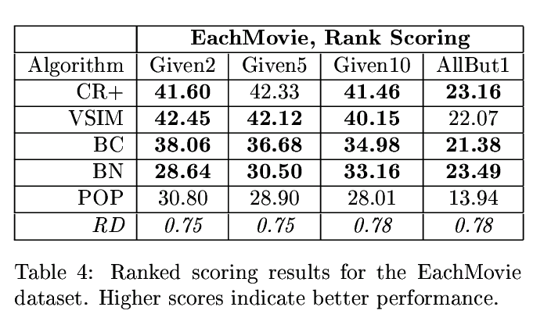
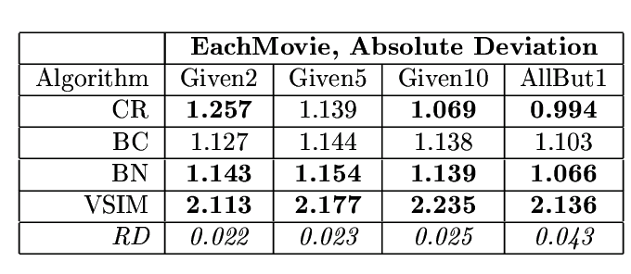
Algorithms for Collaborative Filtering 1: Memory-Based Algorithms (Breese et al, UAI98)
Why are these numbers worse?
soccer score
golf score

Slide 24
Outline
Non-systematic survey of some CF systems
  CF as basis for a virtual community
  memory-based recommendation algorithms
  CF versus content filtering
Algorithms for CF
CF with different inputs
  true ratings
  assumed/implicit ratings

Slide 25


LIBRA Book Recommender
Content-Based Book Recommending Using Learning for Text Categorization. Raymond J. Mooney, Loriene Roy, Univ Texas/Austin; DL-2000
[CF] assumes that a given user’s tastes are generally the same as another user ... Items that have not been rated by a sufficient number of users cannot be effectively recommended. Unfortunately, statistics on library use indicate that most books are utilized by very few patrons. ... [CF] approaches ... recommend popular titles, perpetuating homogeneity.... this approach raises concerns about privacy and access to proprietary customer data.

Slide 26
LIBRA Book Recommender
Database of textual descriptions + meta-information about books (from Amazon.com’s website)
  title, authors, synopses, published reviews, customer comments, related authors, related titles, and subject terms.
Users provides 1-10 rating for training books
System learns a model of the user
  Naive Bayes classifier predicts Prob(user rating>5|book)
System explains ratings in terms of “informative features” and explains features in terms of examples

Slide 27
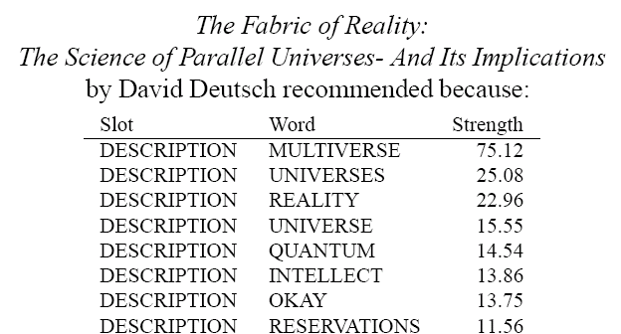
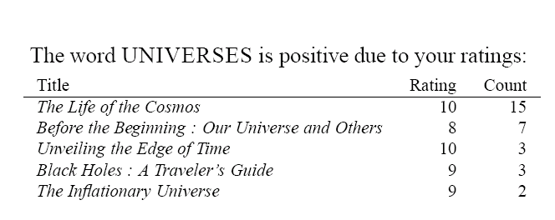
LIBRA Book Recommender
....

Slide 28
LIBRA Book Recommender
Key differences from MovieRecommender:
vs collaborative filtering, recommendation is based on properties of the item being recommended, not tastes of other users
vs memory-based techniques, LIBRA builds an explicit model of the user’s tastes (expressed as weights for different words)
....

Slide 29
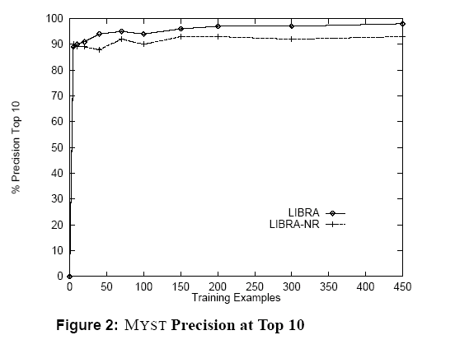
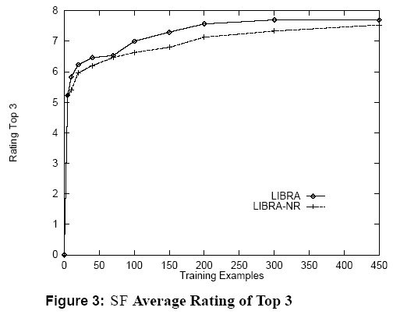
LIBRA Book Recommender
LIBRA-NR = no related author/title features

Slide 30
Collaborative + Content Filtering
As Classification (Basu, Hirsh, Cohen, AAAI98)
Classification task: map (user,movie) pair into {likes,dislikes}
Training data: known likes/dislikes
Test data: active users
Features: any properties of user/movie pair
 |  | Airplane | Matrix | Room with a View | ... | Hidalgo
 |  | comedy | action | romance | ... | action
Joe | 27,M,70k | 1 | 1 | 0 |  | 1
Carol | 53,F,20k | 1 |  | 1 |  | 0
...
Kumar | 25,M,22k | 1 | 0 | 0 |  | 1
U_{a} | 48,M,81k | 0 | 1 | ? | ? | ?

Slide 31
Collaborative + Content Filtering
As Classification (Basu et al, AAAI98)
Examples: genre(U,M), age(U,M), income(U,M),...
genre(Carol,Matrix) = action
income(Kumar,Hidalgo) = 22k/year
Features: any properties of user/movie pair (U,M)
 |  | Airplane | Matrix | Room with a View | ... | Hidalgo
 |  | comedy | action | romance | ... | action
Joe | 27,M,70k | 1 | 1 | 0 |  | 1
Carol | 53,F,20k | 1 |  | 1 |  | 0
...
Kumar | 25,M,22k | 1 | 0 | 0 |  | 1
U_{a} | 48,M,81k | 0 | 1 | ? | ? | ?

Slide 32
Collaborative + Content Filtering
As Classification (Basu et al, AAAI98)
Examples: usersWhoLikedMovie(U,M):
usersWhoLikedMovie(Carol,Hidalgo) = {Joe,...,Kumar}
usersWhoLikedMovie(U_{a}, Matrix) = {Joe,...}
Features: any properties of user/movie pair (U,M)
 |  | Airplane | Matrix | Room with a View | ... | Hidalgo
 |  | comedy | action | romance | ... | action
Joe | 27,M,70k | 1 | 1 | 0 |  | 1
Carol | 53,F,20k | 1 |  | 1 |  | 0
...
Kumar | 25,M,22k | 1 | 0 | 0 |  | 1
U_{a} | 48,M,81k | 0 | 1 | ? | ? | ?

Slide 33
Collaborative + Content Filtering
As Classification (Basu et al, AAAI98)
Examples: moviesLikedByUser(M,U):
moviesLikedByUser(*,Joe) = {Airplane,Matrix,...,Hidalgo}
actionMoviesLikedByUser(*,Joe)={Matrix,Hidalgo}
Features: any properties of user/movie pair (U,M)
 |  | Airplane | Matrix | Room with a View | ... | Hidalgo
 |  | comedy | action | romance | ... | action
Joe | 27,M,70k | 1 | 1 | 0 |  | 1
Carol | 53,F,20k | 1 |  | 1 |  | 0
...
Kumar | 25,M,22k | 1 | 0 | 0 |  | 1
U_{a} | 48,M,81k | 0 | 1 | ? | ? | ?

Slide 34
Collaborative + Content Filtering
As Classification (Basu et al, AAAI98)
genre={romance}, age=48, sex=male, income=81k, usersWhoLikedMovie={Carol}, moviesLikedByUser={Matrix,Airplane}, ...
Features: any properties of user/movie pair (U,M)
 |  | Airplane | Matrix | Room with a View | ... | Hidalgo
 |  | comedy | action | romance | ... | action
Joe | 27,M,70k | 1 | 1 | 0 |  | 1
Carol | 53,F,20k | 1 |  | 1 |  | 0
...
Kumar | 25,M,22k | 1 | 0 | 0 |  | 1
U_{a} | 48,M,81k | 1 | 1 | ? | ? | ?

Slide 35
Collaborative + Content Filtering
As Classification (Basu et al, AAAI98)
genre={romance}, age=48, sex=male, income=81k, usersWhoLikedMovie={Carol}, moviesLikedByUser={Matrix,Airplane}, ...
genre={action}, age=48, sex=male, income=81k, usersWhoLikedMovie = {Joe,Kumar}, moviesLikedByUser={Matrix,Airplane},...
 |  | Airplane | Matrix | Room with a View | ... | Hidalgo
 |  | comedy | action | romance | ... | action
Joe | 27,M,70k | 1 | 1 | 0 |  | 1
Carol | 53,F,20k | 1 |  | 1 |  | 0
...
Kumar | 25,M,22k | 1 | 0 | 0 |  | 1
U_{a} | 48,M,81k | 1 | 1 | ? | ? | ?

Slide 36

Collaborative + Content Filtering
As Classification (Basu et al, AAAI98)
genre={romance}, age=48, sex=male, income=81k, usersWhoLikedMovie={Carol}, moviesLikedByUser={Matrix,Airplane}, ...
genre={action}, age=48, sex=male, income=81k, usersWhoLikedMovie = {Joe,Kumar}, moviesLikedByUser={Matrix,Airplane},...
Classification learning algorithm: rule learning (RIPPER)
  If NakedGun33/13 moviesLikedByUser and Joe usersWhoLikedMovie and genre=comedy then predict likes(U,M)
  If age>12 and age<17 and HolyGrail moviesLikedByUser and director=MelBrooks then predict likes(U,M)
  If Ishtar moviesLikedByUser then predict likes(U,M)

Slide 37
Collaborative + Content Filtering
As Classification (Basu et al, AAAI98)
Classification learning algorithm: rule learning (RIPPER)
  If NakedGun33/13 moviesLikedByUser and Joe usersWhoLikedMovie and genre=comedy then predict likes(U,M)
  If age>12 and age<17 and HolyGrail moviesLikedByUser and director=MelBrooks then predict likes(U,M)
  If Ishtar moviesLikedByUser then predict likes(U,M)
Important difference from memory-based approaches:
  again, Ripper builds an explicit model—of how user’s tastes relate items, and to the tastes of other users

Slide 38
Basu et al 98 - results
Evaluation:
  Predict liked(U,M)=“M in top quartile of U’s ranking” from features, evaluate recall and precision
  Features:
    Collaborative: UsersWhoLikedMovie, UsersWhoDislikedMovie, MoviesLikedByUser
    Content: Actors, Directors, Genre, MPAA rating, ...
    Hybrid: ComediesLikedByUser, DramasLikedByUser, UsersWhoLikedFewDramas, ...
Results: at same level of recall (about 33%)
  Ripper with collaborative features only is worse than the original MovieRecommender (by about 5 pts precision – 73 vs 78)
  Ripper with hybrid features is better than MovieRecommender (by about 5 pts precision)

Slide 39
Outline
Non-systematic survey of some CF systems
  CF as basis for a virtual community
  memory-based recommendation algorithms
  visualizing user-user via item distances
  CF versus content filtering
  Combining CF and content filtering
  CF as matching content and user
Algorithms for CF
  Probabilistic model-based CF
CF with different inputs
  true ratings
  assumed/implicit ratings

Slide 40
CF as density estimation
(Breese et al, UAI98)
Estimate Pr(R_{ij}=k) for each user i, movie j, and rating k
Use all available data to build model for this estimator
R_{ij} | Airplane | Matrix | Room with a View | ... | Hidalgo
Joe | 9 | 7 | 2 | ... | 7
Carol | 8 | ? | 9 | ... | ?
... | ... | ... | ... | ... | ...
Kumar | 9 | 3 | ? | ... | 6

Slide 41
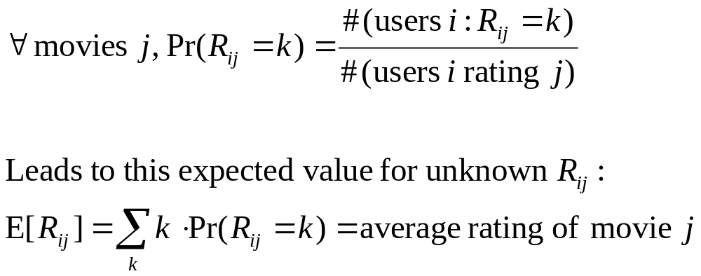
CF as density estimation
(Breese et al, UAI98)
Estimate Pr(R_{ij}=k) for each user i, movie j, and rating k
Use all available data to build model for this estimator
A simple example:

Slide 42
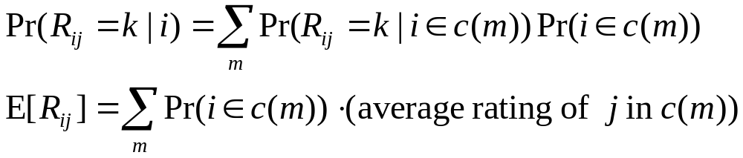
CF as density estimation
(Breese et al, UAI98)
Estimate Pr(R_{ij}=k) for each user i, movie j, and rating k
Use all available data to build model for this estimator
More complex example:
  Group users into M “clusters”: c(1), ..., c(M)
  For movie j,
estimate by counts

Slide 43
CF as density estimation: BC
(Breese et al, UAI98)
Group users into clusters using Expectation-Maximization:
  Randomly initialize Pr(R_{m,j}=k) for each m
  (i.e., initialize the clusters differently somehow)
  E-Step: Estimate Pr(user i in cluster m) for each i,m
  M-Step: Find maximum likelihood (ML) estimator for R_{ij} within each cluster m
    Use ratio of #(users i in cluster m with rating R_{ij}=k) to #(user i in cluster m ), weighted by Pr(i in m) from E-step
  Repeat E-step, M-step until convergence

Slide 44
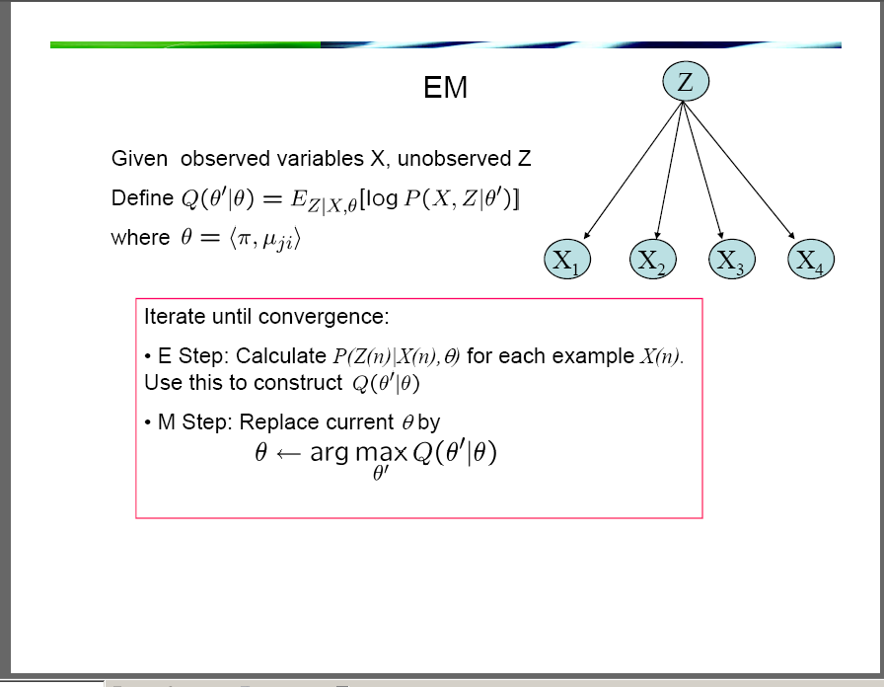

Slide 45
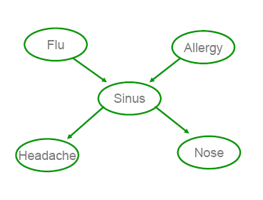
CF as density estimation: BN
(Breese et al, UAI98)
BC assumes movie ratings within a cluster are independent.
Bayes Network approach allows dependencies between ratings, but does not cluster. (Networks are constructed using greedy search.)
ID4
MIB
10kBC
Jumper
Juno

Slide 46
Algorithms for Collaborative Filtering 2: Memory-Based Algorithms (Breese et al, UAI98)
soccer score
golf score

Slide 47
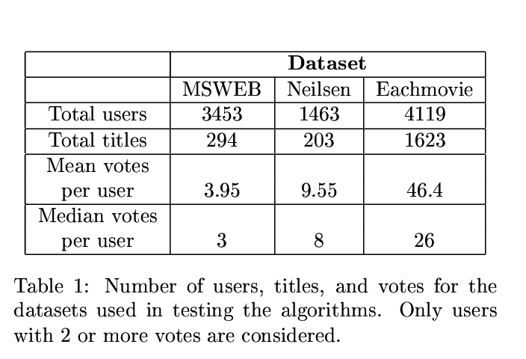
Datasets are different...
fewer items to recommend
fewer votes/user

Slide 48
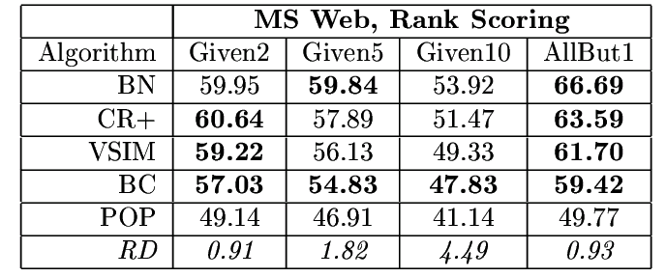
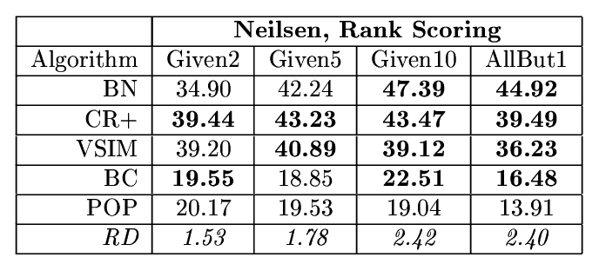
Results on MS Web & Nielson’s
soccer score
soccer score

Slide 49
Outline
Non-systematic survey of some CF systems
  CF as basis for a virtual community
  memory-based recommendation algorithms
  visualizing user-user via item distances
  CF versus content filtering
  Combining CF and content filtering
  CF as matching content and user
Algorithms for CF
  Probabilistic model-based CF
  Probabilistic memory-based CF?
CF with different inputs
  true ratings
  assumed/implicit ratings

Slide 50
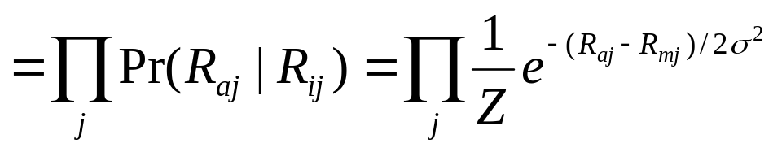
Personality Diagnosis
(Pennock et al, UAI 2000)
Collaborative Filtering by Personality Diagnosis: A Hybrid Memory- and Model-Based Approach, Pennock, Horvitz, Lawrence & Giles, UAI 2000
Basic ideas:
  assume Gaussian noise applied to all ratings
  treat each user as a separate cluster m
  Pr(user a in cluster i) = w(a,i)

Slide 51
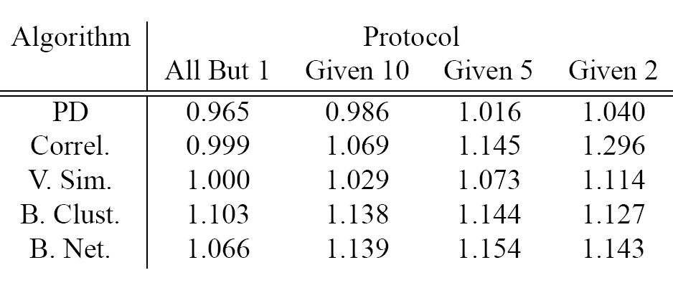
Personality Diagnosis
(Pennock et al, UAI 2000)
Evaluation (EachMovie, following Breese et al):

Slide 52
Outline
Non-systematic survey of some CF systems
  CF as basis for a virtual community
  memory-based recommendation algorithms
  visualizing user-user via item distances
  CF versus content filtering
  Combining CF and content filtering
  CF as matching content and user
Algorithms for CF
  Probabilistic model-based CF
  Probabilistic memory-based CF
CF with different inputs
  true ratings
  assumed/implicit ratings
  ratings inferred from Web pages

Slide 53
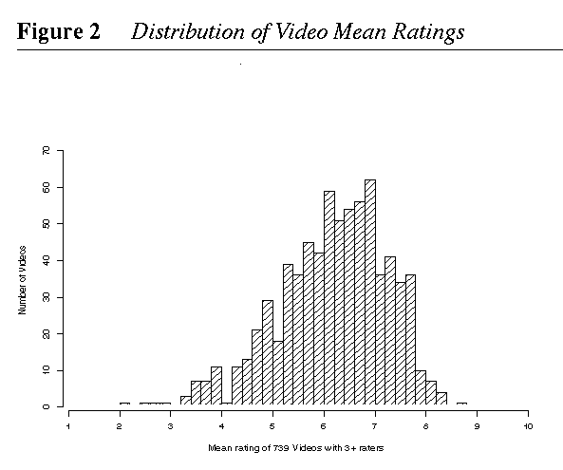
Another key observation: rated movies tend to have positive ratings:
i.e., people rate what they watch, and watch what they like
Question: Can observation replace explicit rating?

Slide 54
CF with pseudo-users
Web-Collaborative Filtering: Recommending Music by Crawling The Web, Cohen and Fan, WWW-2000
Goal: community filtering without a community
  Approximate community with information automatically extracted from web pages.
Outline:
  problem & baseline CF system
  creating “pseudo-users” from web pages
  CF results with “pseudo-users”

Slide 55
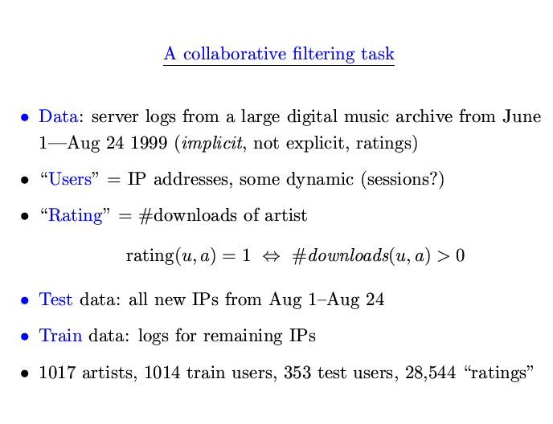

Slide 56
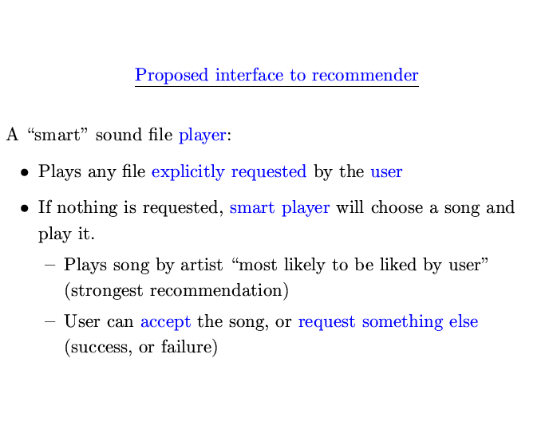

Slide 57
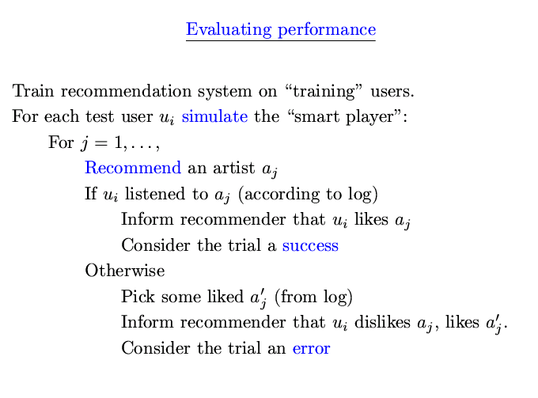

Slide 58
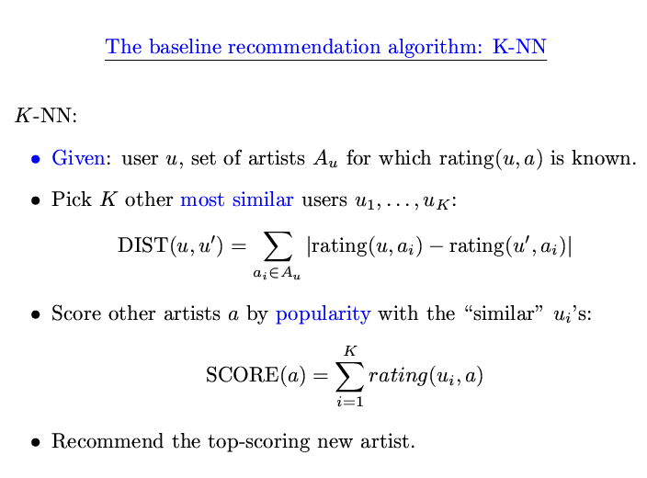

Slide 59
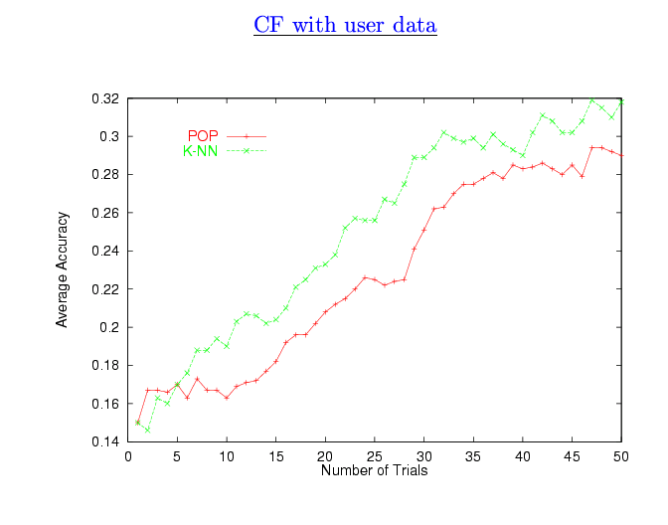

Slide 60
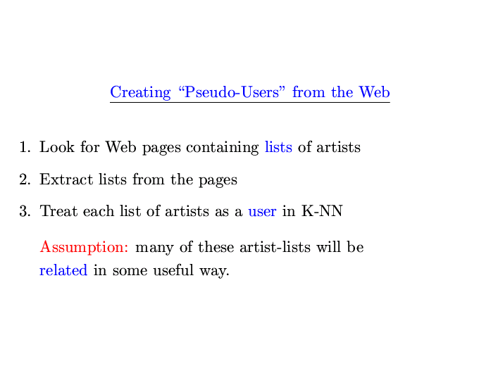

Slide 61
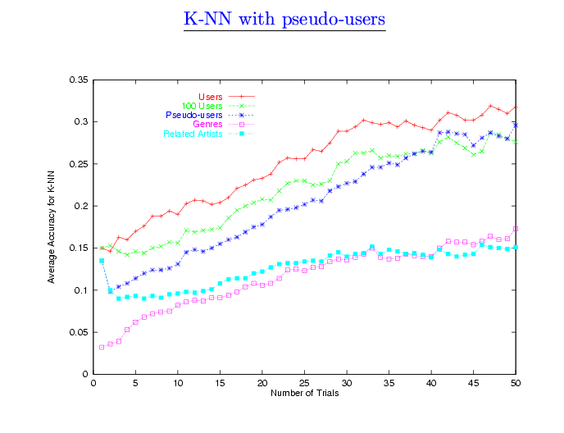

Slide 62
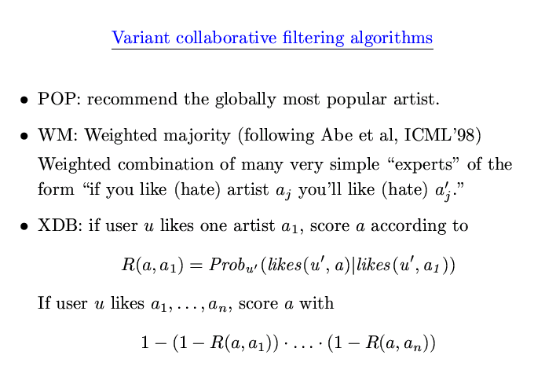

Slide 63
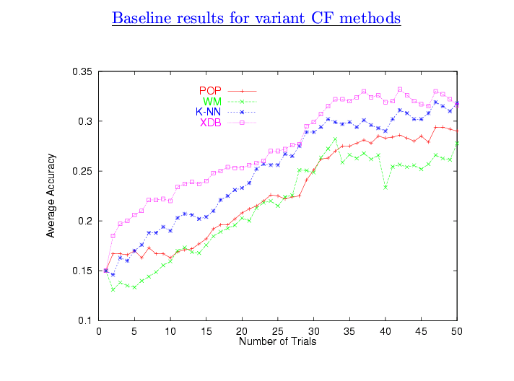

Slide 64
Outline
Non-systematic survey of some CF systems
  CF as basis for a virtual community
  memory-based recommendation algorithms
  visualizing user-user via item distances
  CF versus content filtering
Algorithms for CF
CF with different inputs
  true ratings
  assumed/implicit ratings
Conclusions/Summary

Slide 65
Summary
BN
RIPPER +
hybrid
features
RIPPER
model-based
LIBRA
RankBoost
(many rounds)
LIBRA-NR
music rec.
with web pages
(XDB)
BC
RankBoost
(k rounds)
PD
memory-based
CR
music rec.
with web pages
(k-NN)
VSIM
k-NN
paper rec.
as matching
MovieRecommender
collaborative/social
content-based

Slide 66
Final Comments
CF is one of a handful of learning-related tools that have had broadly visible impact:
  Google, TIVO, Amazon, personal radio stations, ...
Critical tool for finding “consensus information” present in a large community (or large corpus of web pages, or large DB of purchase records, ....)
  Similar in some respects to Q/A with corpora
Science is relatively-well established
  in certain narrow directions, on a few datasets
Set of applications still being expanded
Some resources:
  http://www.sims.berkeley.edu/resources/collab/
  http://www.cs.umn.edu/Research/GroupLens/
  http://www.cis.upenn.edu/~ungar/CF/

